Slide 1
Project on Body Shop Management System
A Web based system for Body Shop Management System.

Slide 2
A
Project Report on
“Body Shop Management System”
Submitted to
Savitribai Phule Pune University,
Under Esteemed Guidance of
Prof. P.G.Gudaghe,
Head-of-Dept.(HOD)
By
Wavare Aditya Tushar
Chavanke Siddharth Arun
Students of 3rd Year BBA_CA (6TH Semester)
Of
DEPARTMENT OF BBA(COMPUTER APPLICATION)

Slide 3
Introduction to Project
Inventory–
This software maintains inventory of all body shop and also sales and purchase of all body shop. Inventory is most important part in any business so does in body shop.
Car Wash–
This maintains all the details of the vehicles which are available and for washing and ready for delivery. Car Wash stores the details like car type, fuel type and timing allotted to each customer for washing.
Denting–
This maintains all the details of the vehicles for which are available for denting and color change.

Slide 4
Problem Statement
Complex Repair Processes
Modern vehicles are equipped with advanced technologies, including intricate electronic systems and safety features. Body shop technicians often struggle with accessing accurate repair information, resulting in longer repair times and potential errors.
Inefficient Workflow Management
Manual processes for scheduling appointments, managing inventory, ordering parts, and tracking repair progress lead to inefficiencies and delays. This results in longer turnaround times, dissatisfied customers, and decreased revenue.
Limited Digital Integration
Many body shops still rely on paper-based systems for estimates, invoices, and customer communications. The lack of digital integration hampers productivity, customer convenience, and the ability to analyze key performance metrics.

Slide 5
Objective Of The System
At present, there is no system for bicycle rental businesses in colleges and universities to update and share bicycle information in a timely manner, resulting in low bicycle utilization rate, confusion of rental and income management.
This projects aims to design a campus bicycle rental management system to solve this problem eventually. The system helps students efficiently access bicycle information, making it easier for businesses to rent bicycles and manage their income.
In the bicycle rental management system, we can search all the rental bicycle information and rental records online and anytime, and can also score the rental experience. The administrator updates the user and bicycle information in a timely manner, improves the rental registration and completed orders, and checks the daily income.

Slide 6
Scope Of The Project
Repair Management
Track and manage all repair orders, including customer details, vehicle information, labor hours, and parts used.
Inventory Control
Monitor and update inventory levels in real-time, automate reordering of parts, and track supplier information.
Appointment Scheduling
Allow customers to book appointments online, view available slots, and receive automated reminders.
Integration Challenges
The integration of the new system with existing legacy software or hardware may pose compatibility issues.

Slide 7
Need Of The Project
Optimize Repair Efficiency
Reduce average repair times by 20% within the first year of implementing the BSMS.
Increase the number of repairs completed per technician by 15% through streamlined processes and improved resource utilization.
Enhance Customer Satisfaction
Achieve a customer satisfaction rating of 90% or higher based on post-service surveys.
Reduce customer complaints related to communication and repair delays by 30% within the first six months.
Improve Revenue Generation
Increase overall revenue by 25% through upselling of additional services and improved pricing accuracy.
Expand customer base by 20% through enhanced online presence, marketing, and positive customer reviews.

Slide 8
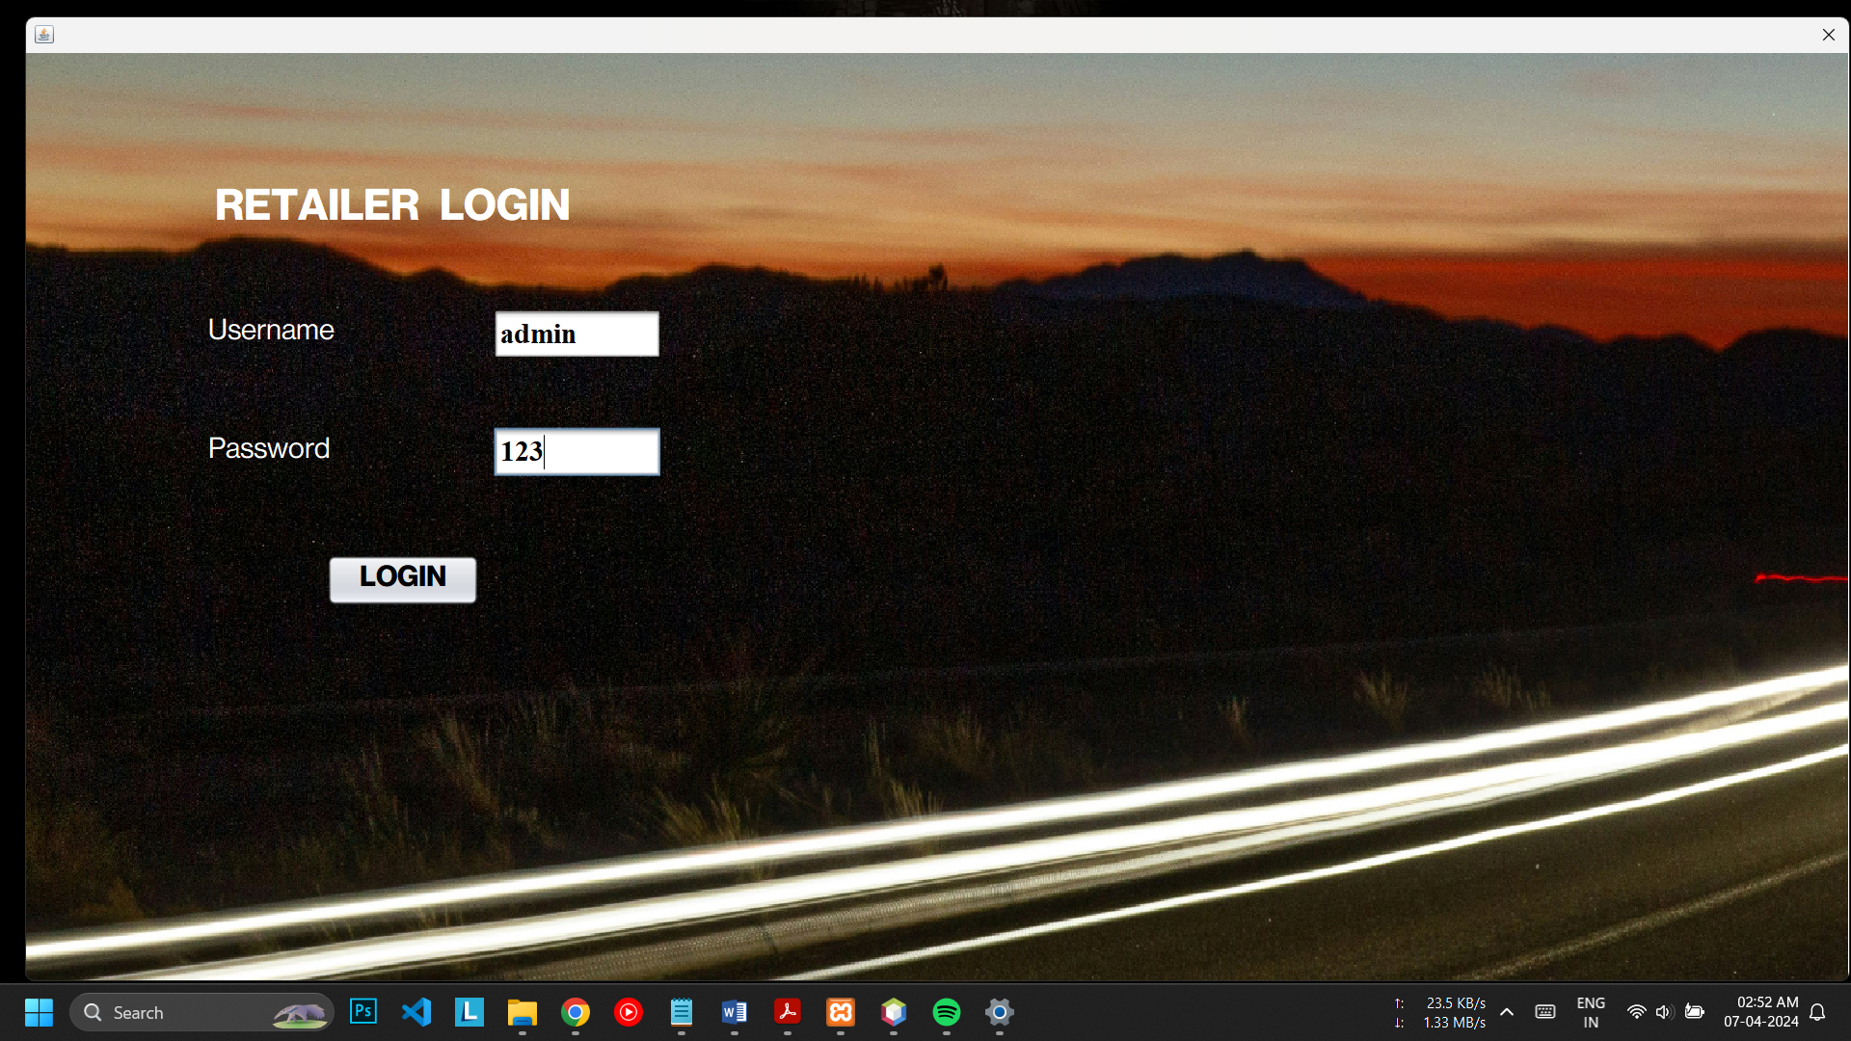
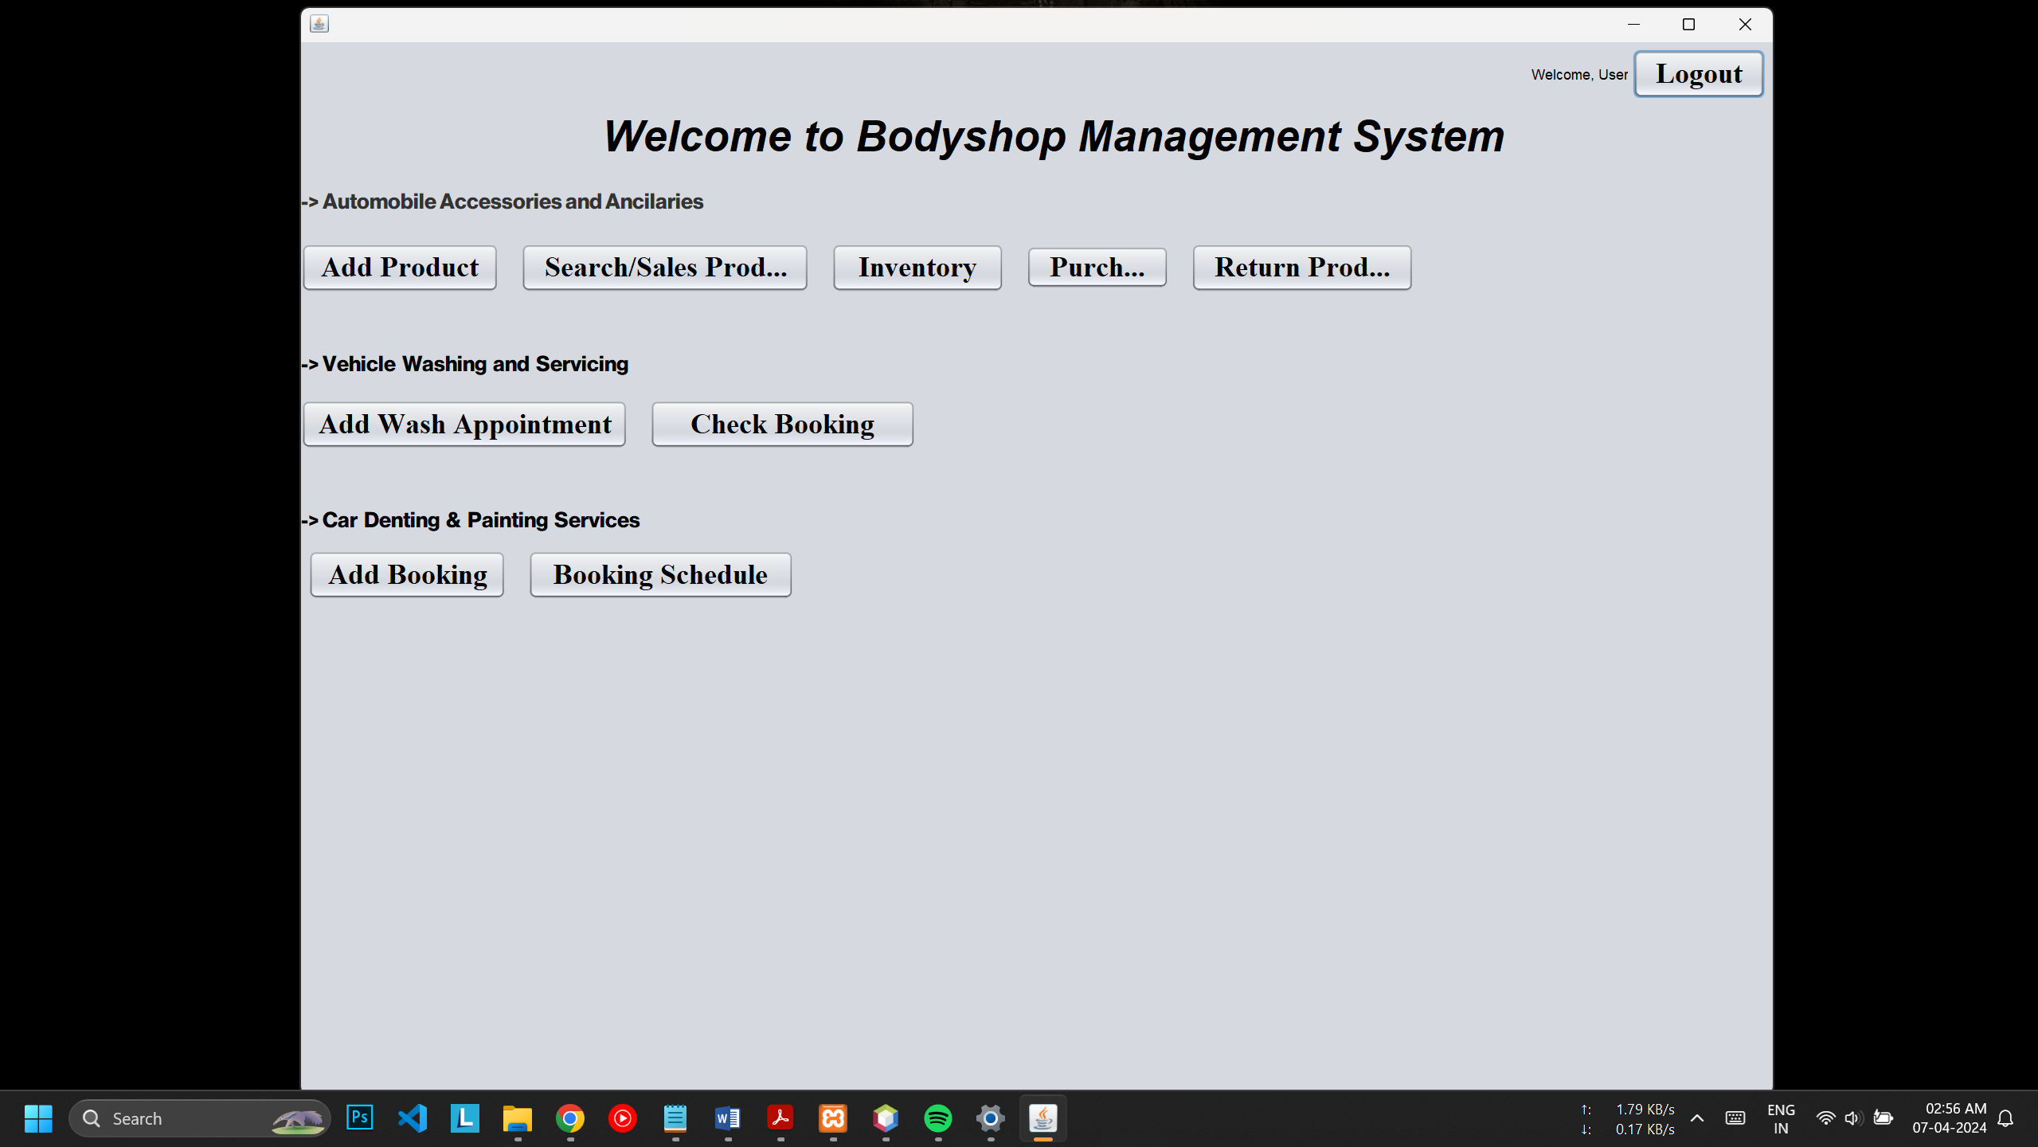
1. Screenshot of Login Page
2. Screenshot of Main Page

Slide 9
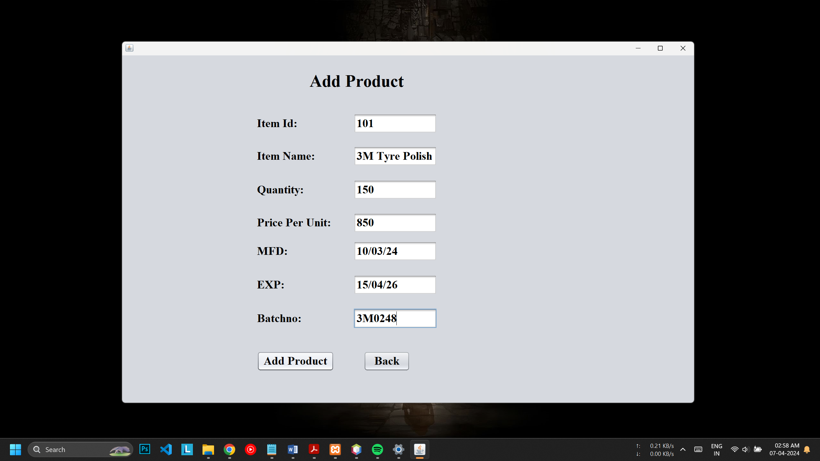
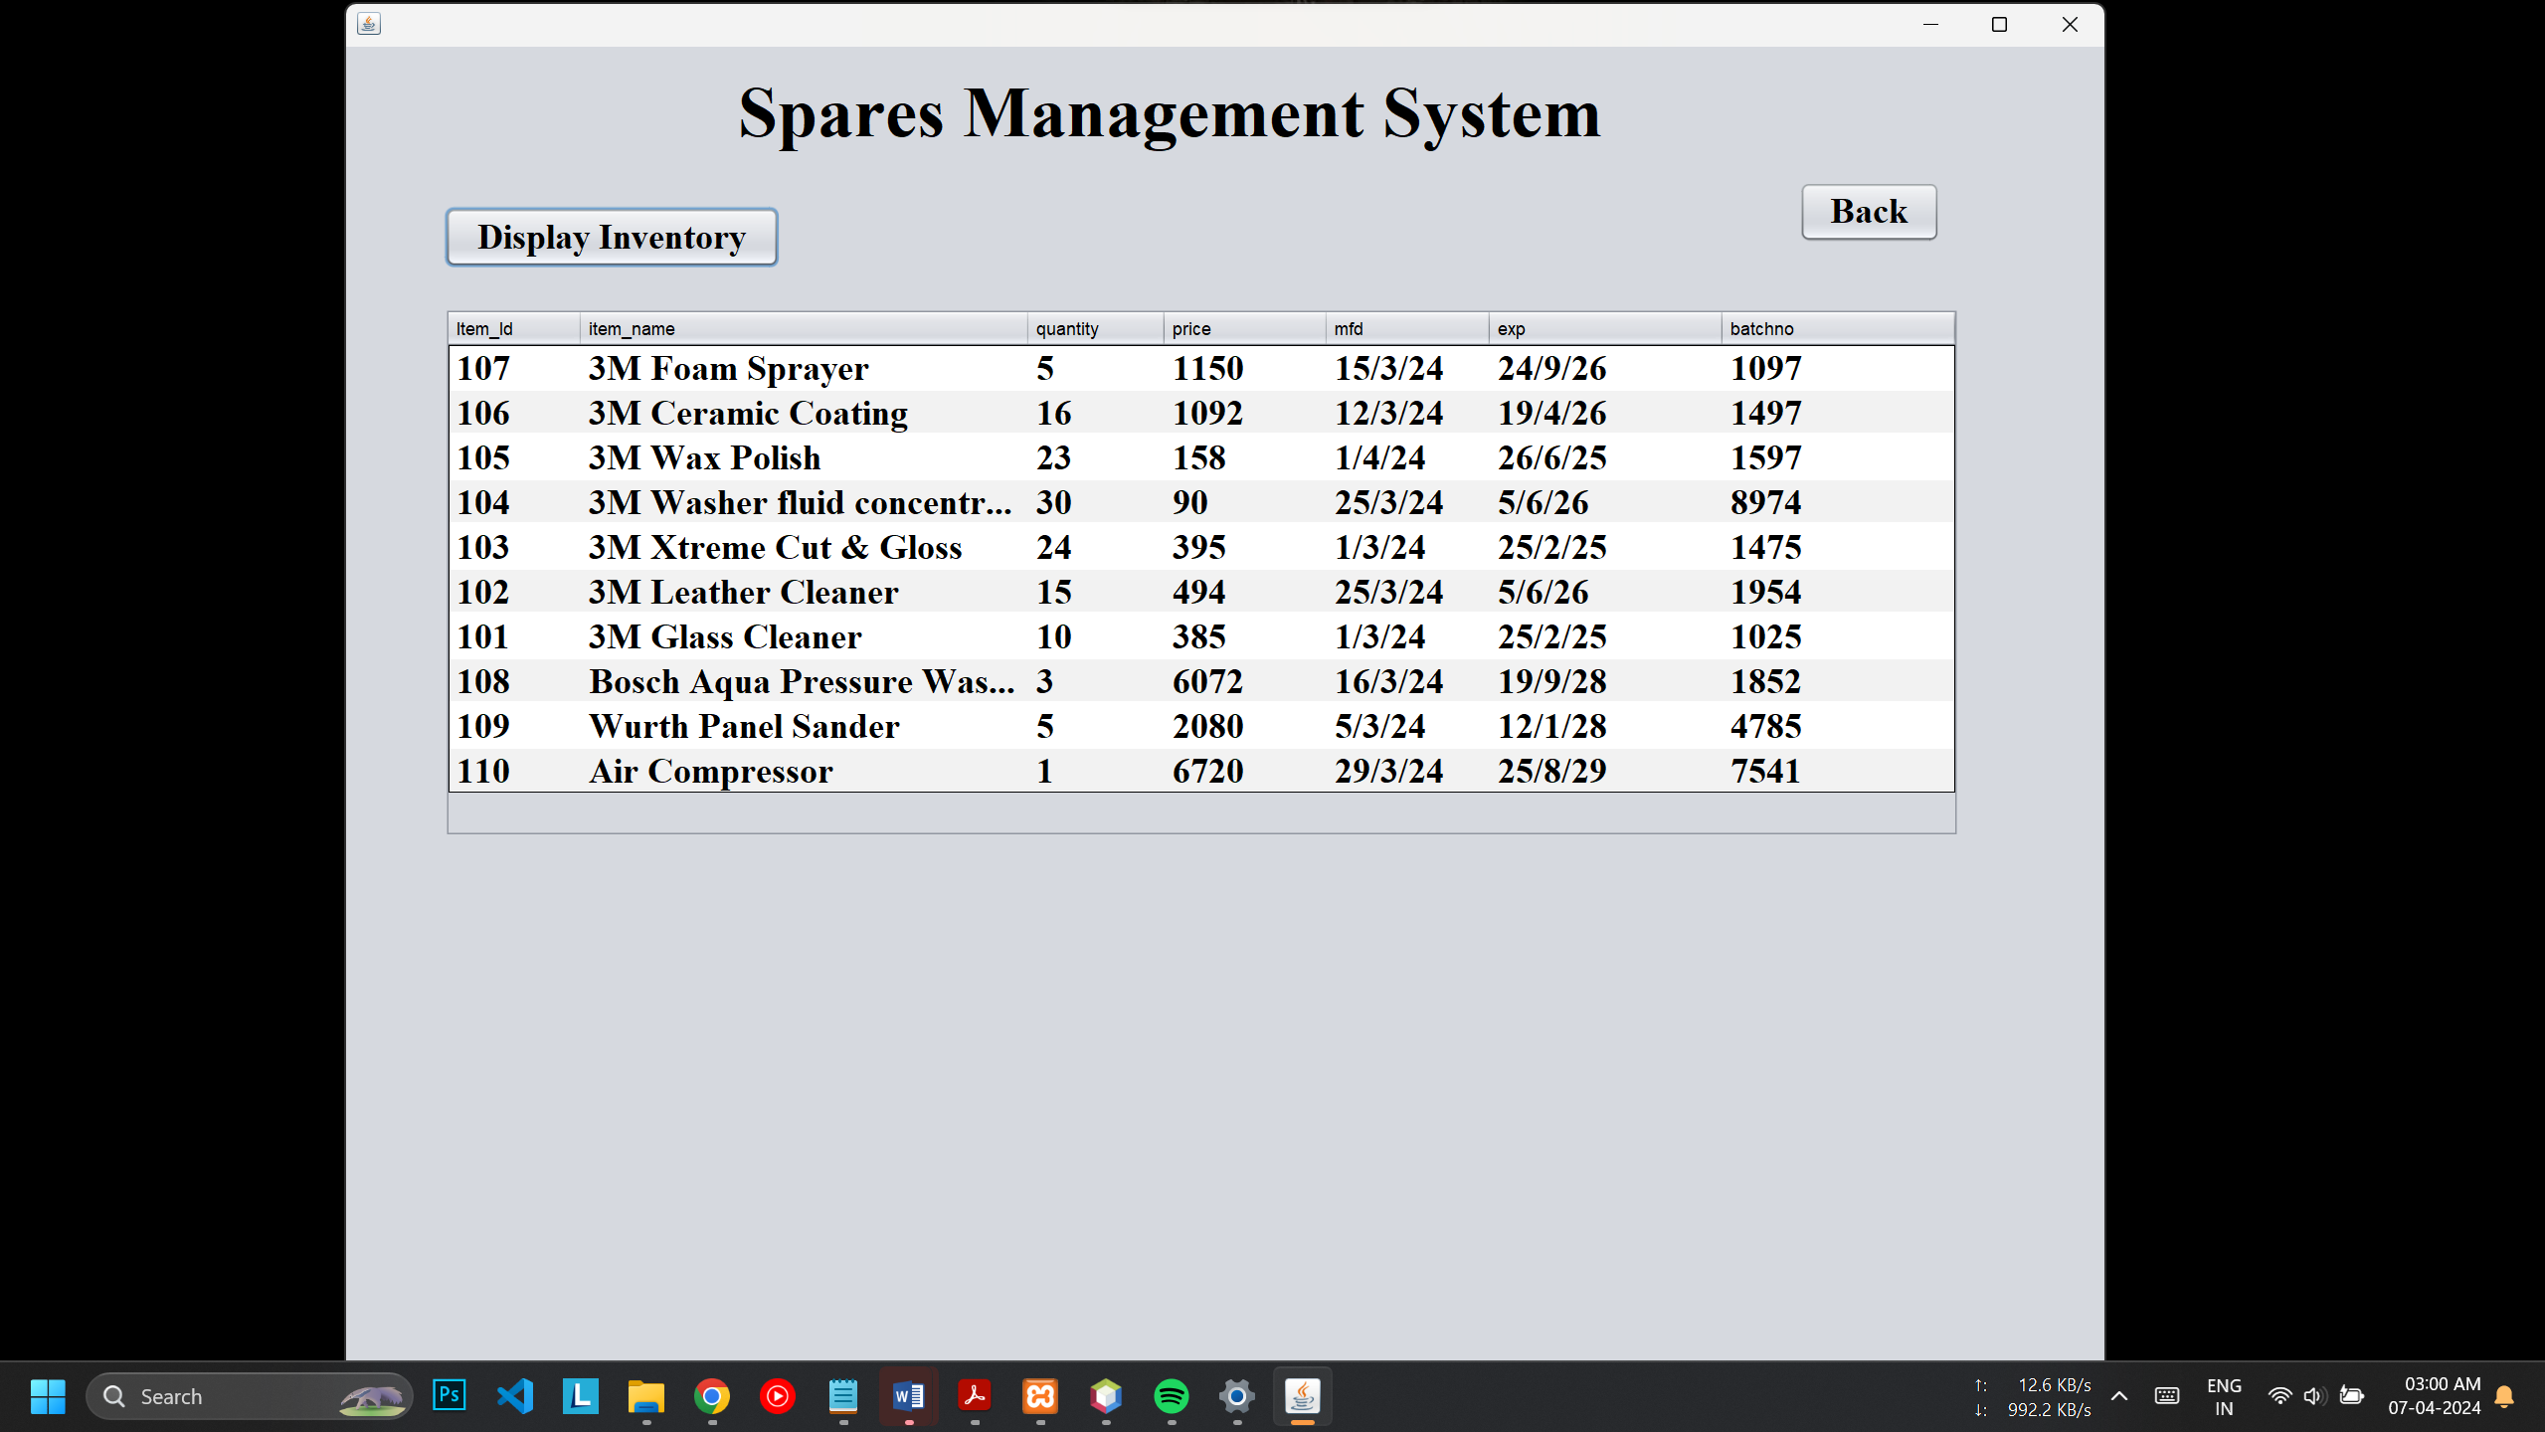
3. Inventory Adding Page
4. All Inventory Items

Slide 10
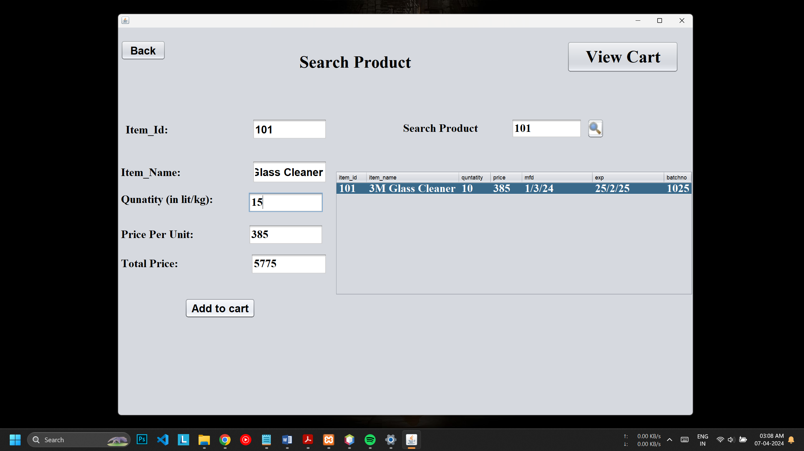
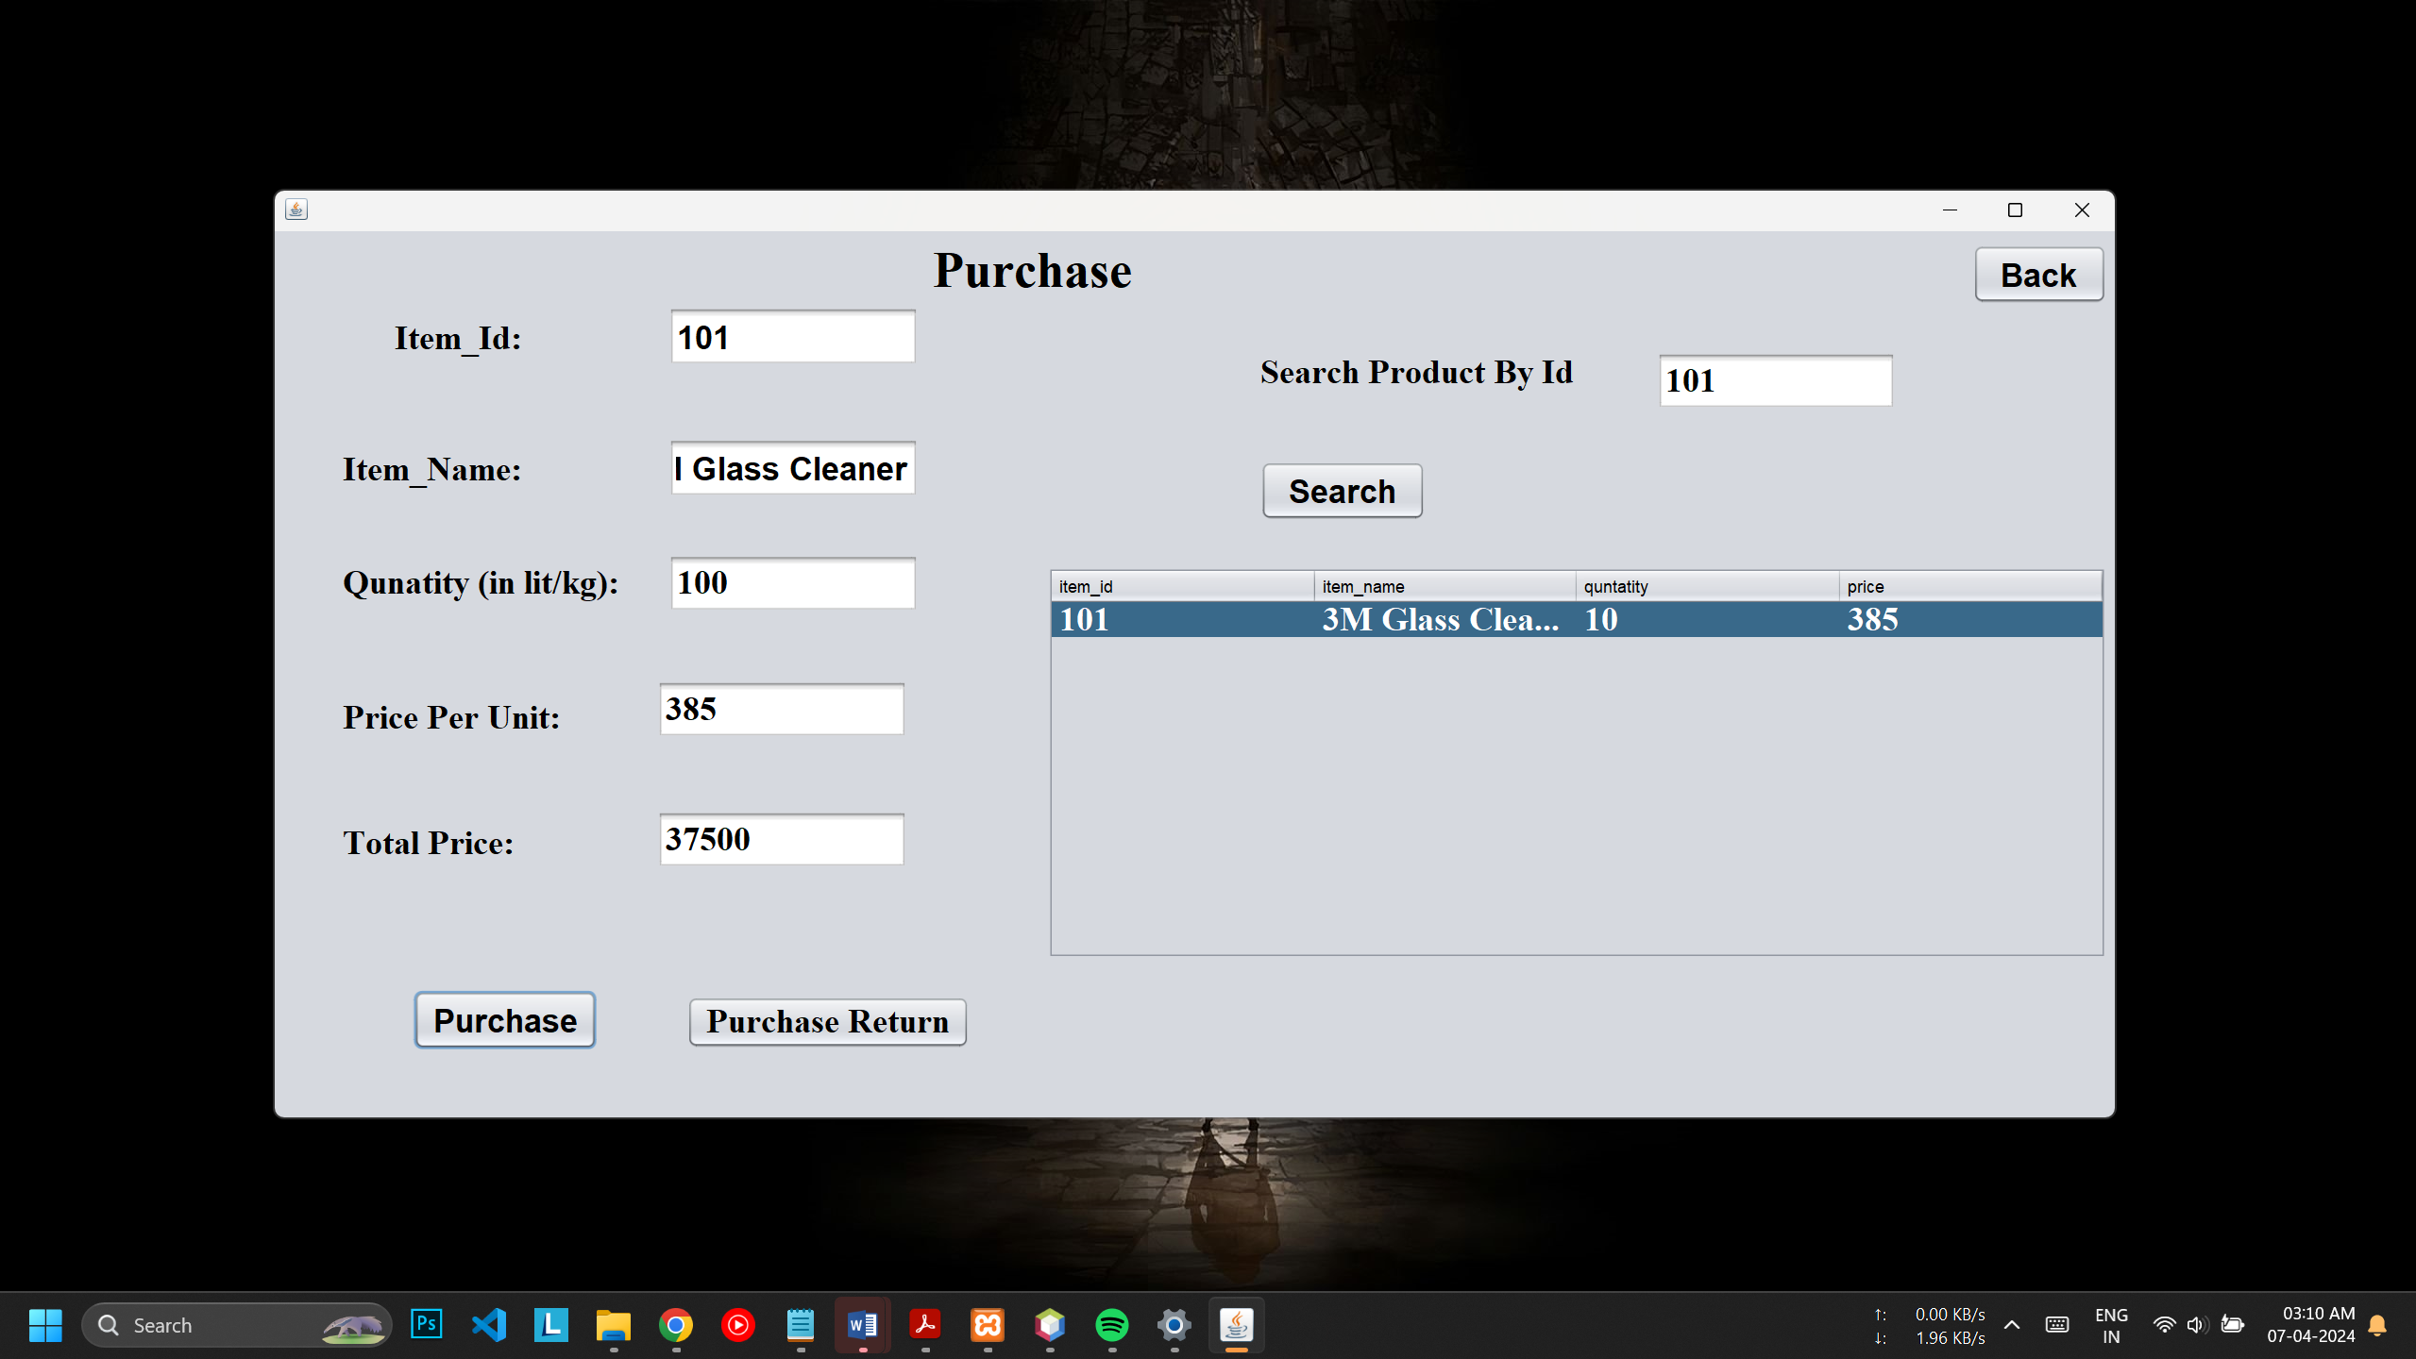
6. Search Product
7. Purchase Window

Slide 11
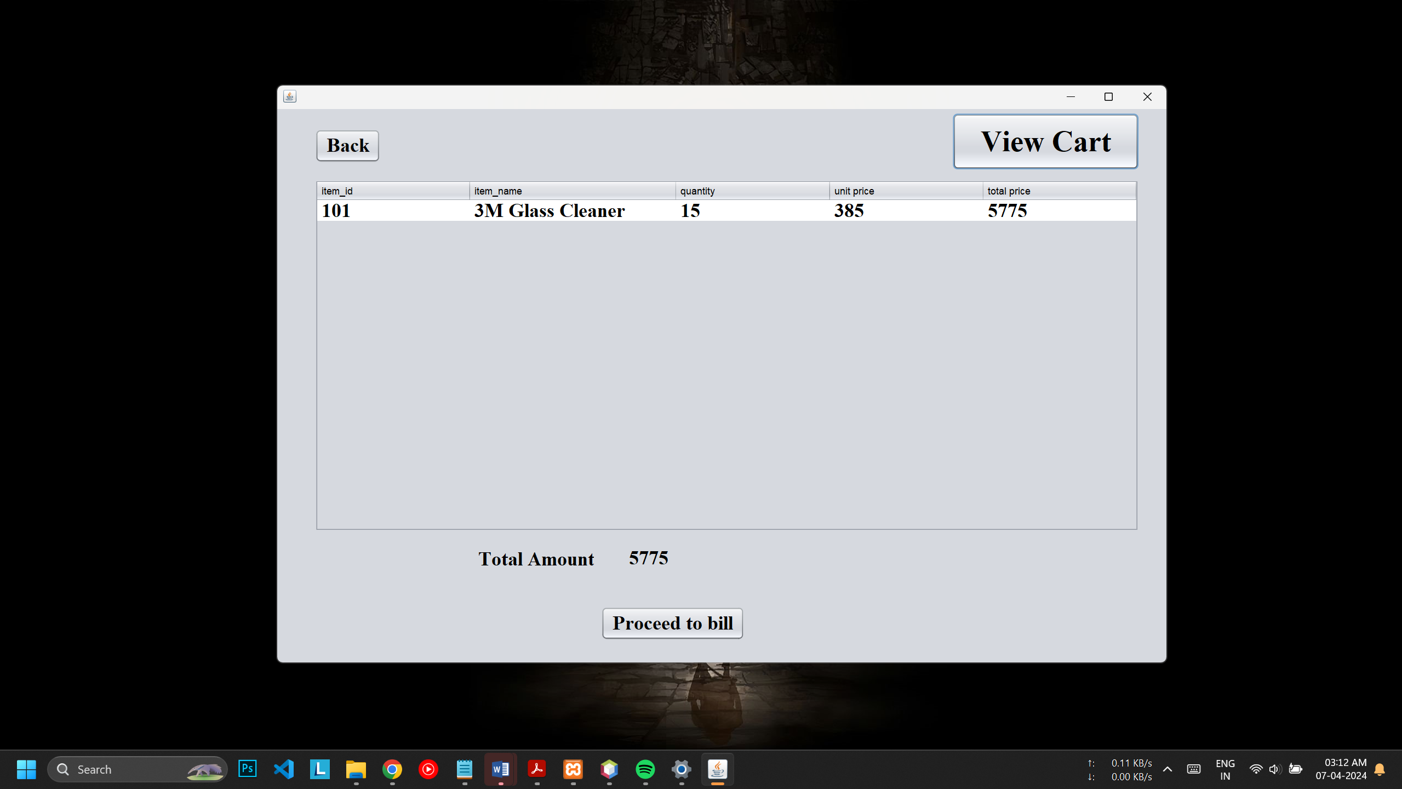
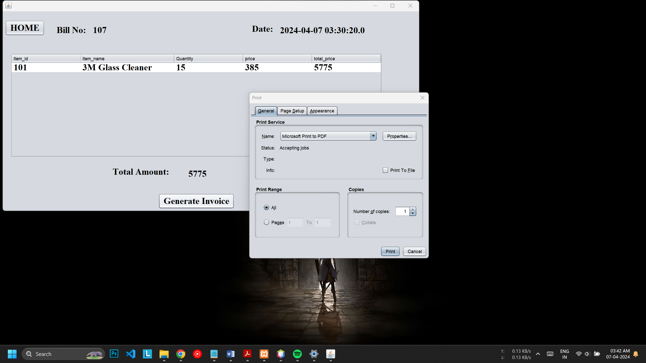
7. Cart
8. Billing and Printing

Slide 12
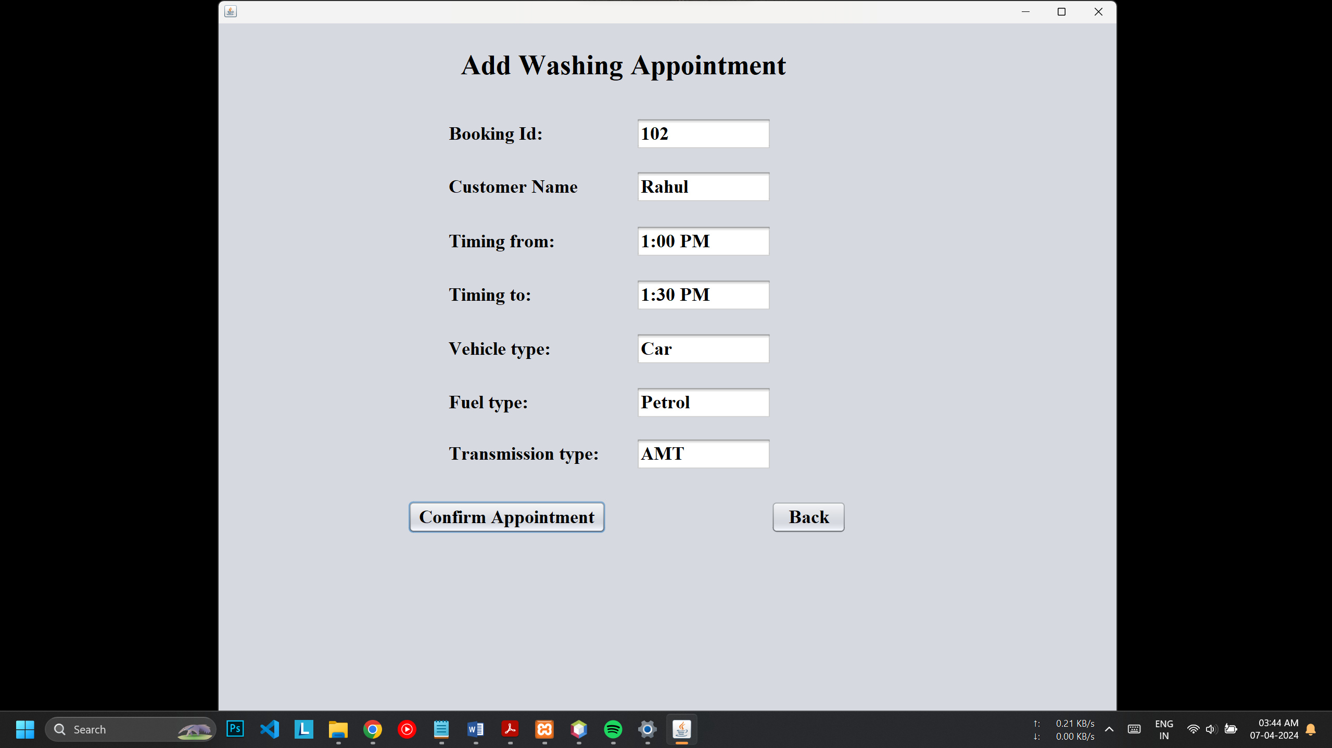
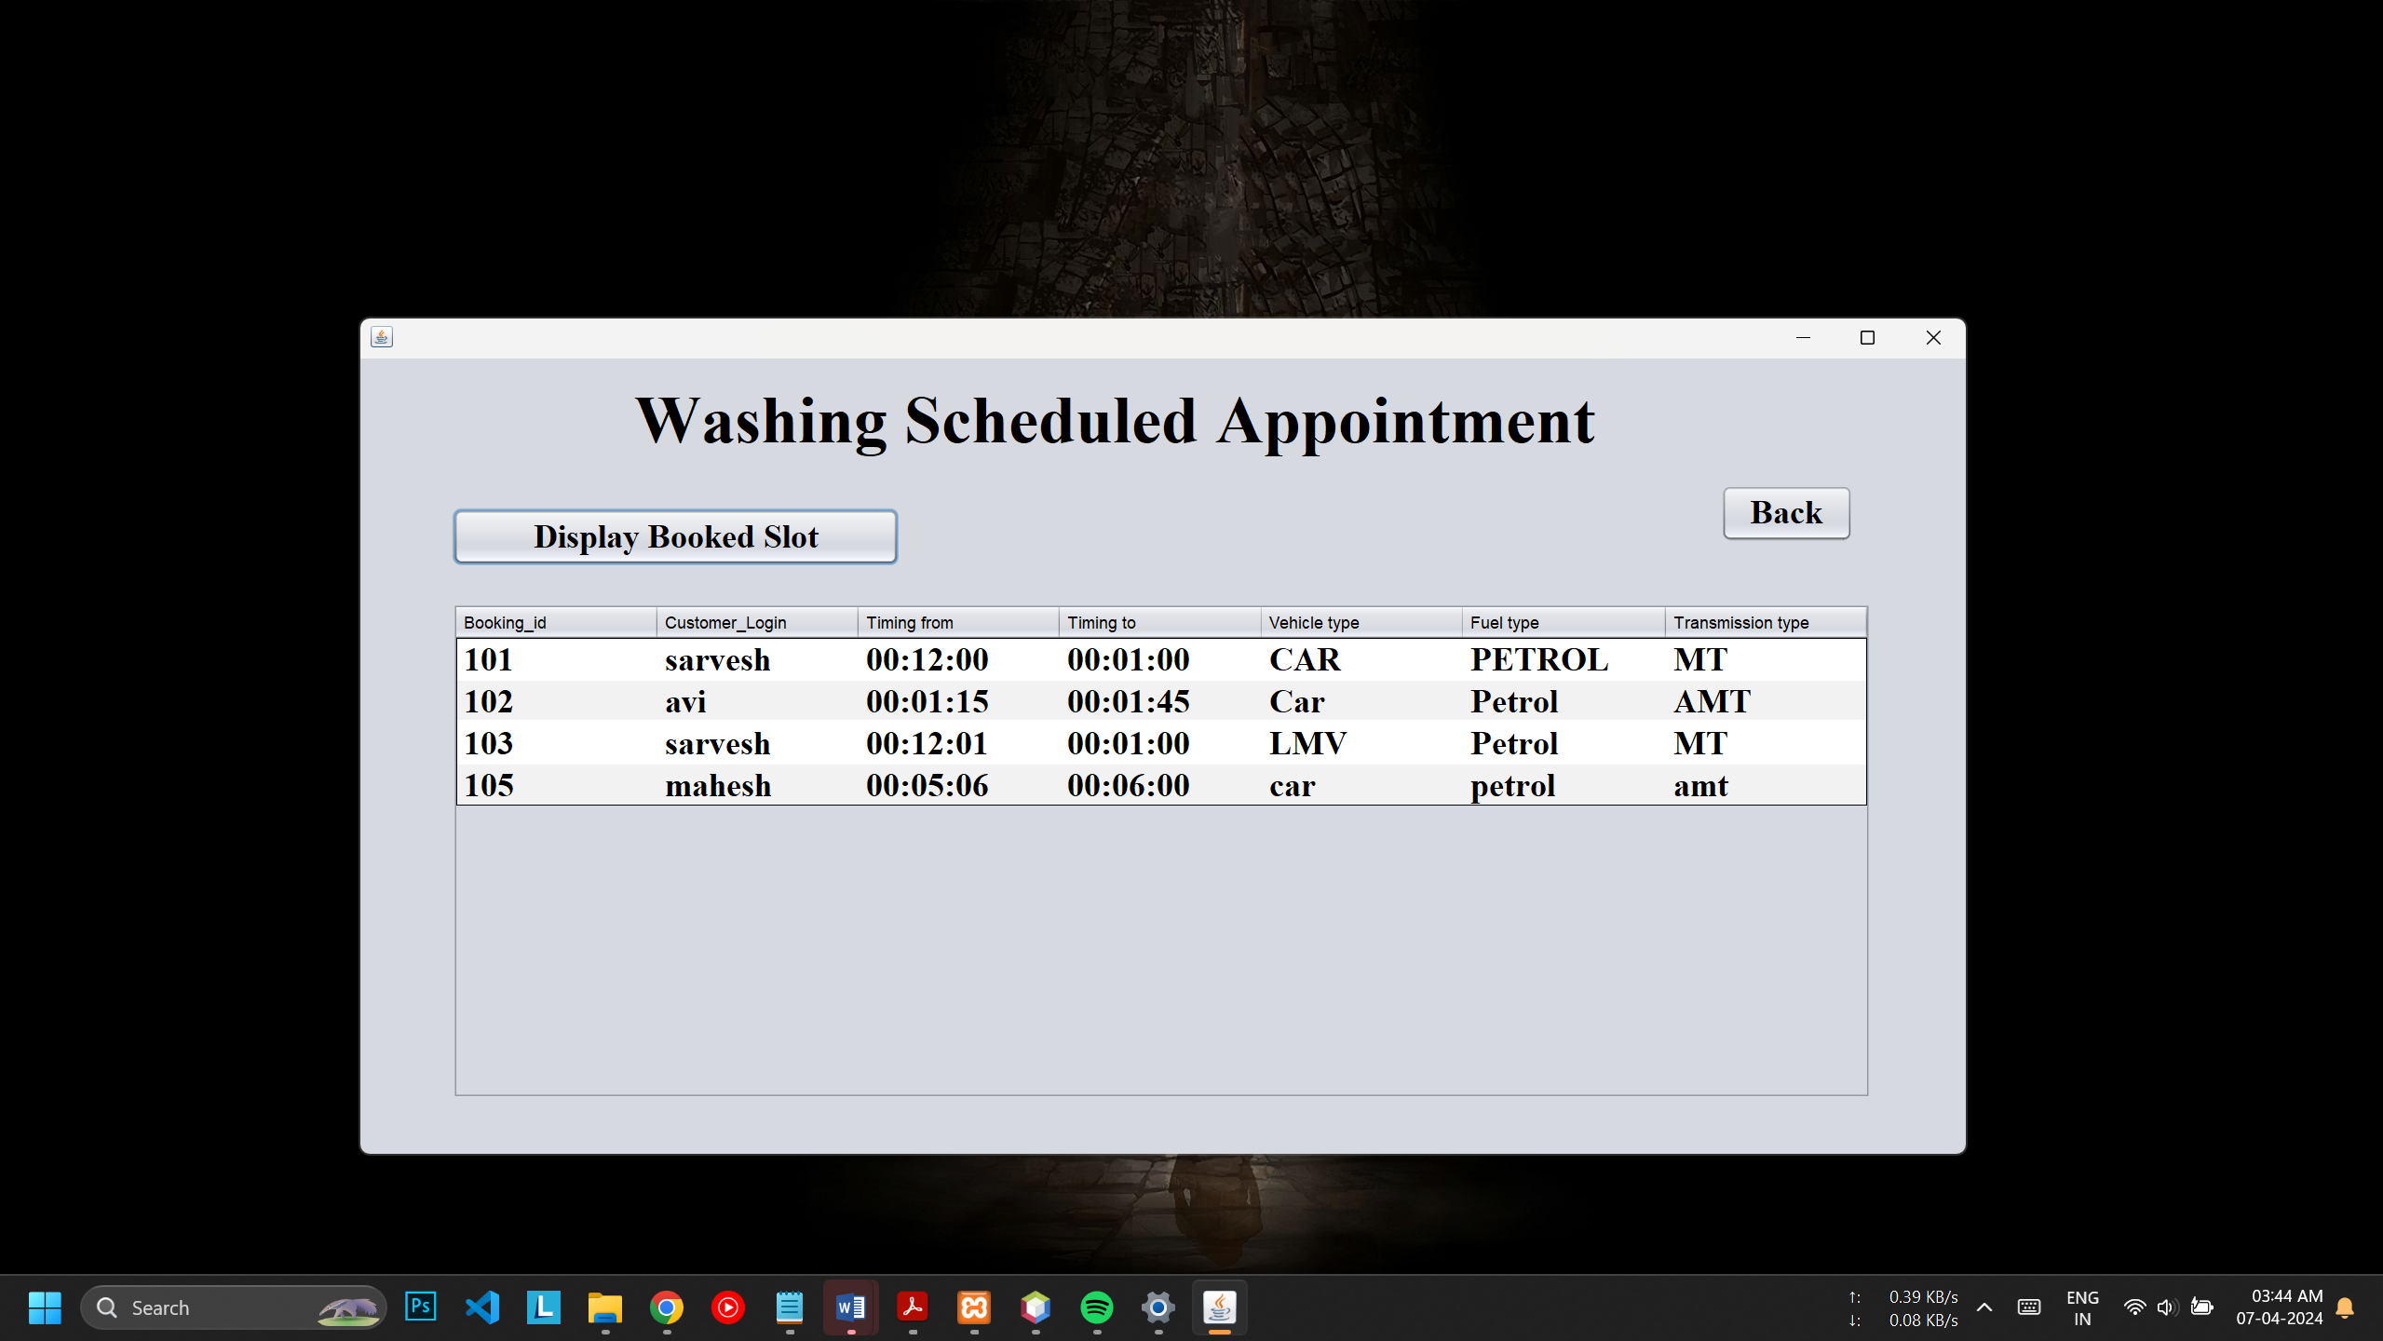
9. Add Washing Appointment
10. Display Washing Details

Slide 13
THANK YOU!!!
-X-X-X-X-X-X-X-X-X-X-X-X-X-X-X-X-X-X-X-X-X-X-X-X-X-X-X-X-X-X-X-X-X-X-X-

